Slide 1
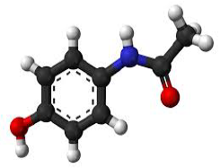


Non-Steroidal Anti-Inflammatory Drugs (NSAIDs)
Mr. ALETI VAMSI
Assistant Professor
Department of Pharmaceutical Chemistry
M.A.M College of Pharmacy, Narasaraopet

Slide 2
NSAIDs:
NSAIDs are drugs with analgesics (pain reducing), anti pyretic (fever reducing), reduce inflammation (redness and swelling).
NSAIDs are non norcotic drugs.
They are associated with no. of side effects. The common side effects are nausea, diarrehea, constipation, vomiting, rashes, dizziness etc
The most serious side effects are kidney failure and liver failures.
Used to treat Headaches, painful periods, toothache and sports injuries.

Slide 3
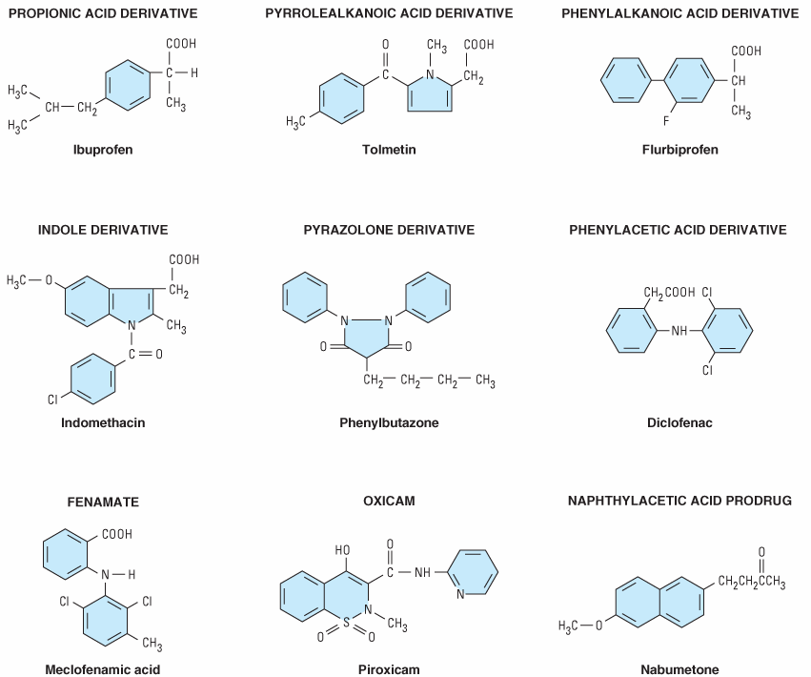

Slide 4

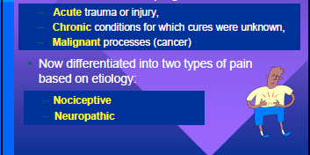

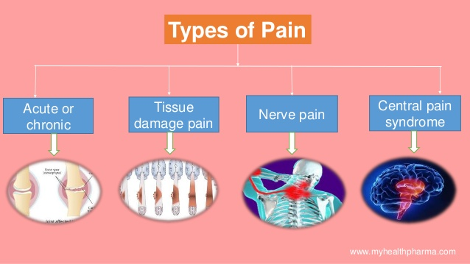

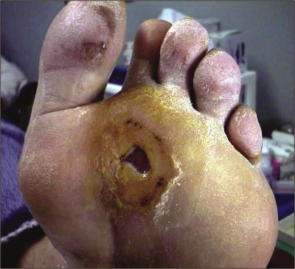
Types of Pains:

Slide 5
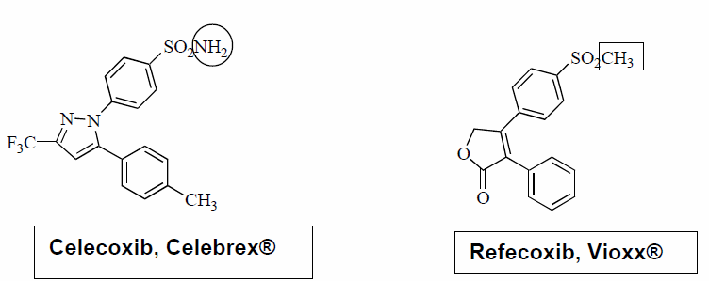
Selective COX-2 Inhibitors
These drugs acts as anti inflamatory agents by directlly inhibiting COX2 enzyme.
These drugs reduce the risk of peptic ulcers.
After several COX 2 inhibitors for marketing, data from clinical trails revealed that, these drugs are cause incresed heart attack and strokes
Some of the agents are taken out from the market
COX-2 inhibitors do not contain carboxylic acid groups. They have different chemical structures

Slide 6

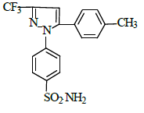
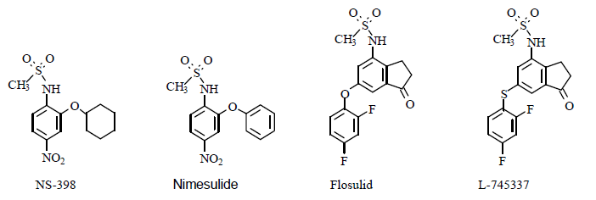
Selective COX-2 Inhibitors - Celecoxib
Celecoxib is in a class of NSAIDs called COX-2 inhibitors It is used to relieve pain, swelling.
Synthesis of Celecoxib: ethyl trifluoroacetate and methylacetophenone react to give 4-methyltrifluoroacetyl benzophenone. Treatment with 4- hydrazine benzensulfonamide results in closing of pyrazole ring to give celecoxib.

Slide 7

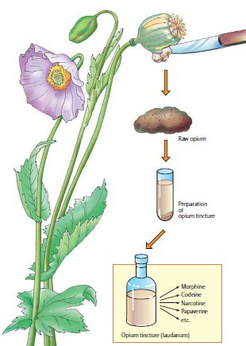
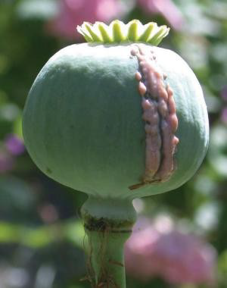
OPIOID ANALGESICS
The opioid analgesics which are prescription only medicines that are very potent, being chemically related to morphine. Opioid analgesics are prescribed for moderate to severe pain
OPIUM, the greek name for poppy juice. Is obtained from the juice of the papaver somniferum.
Extraction of Poppy to Opioids:

Slide 8
Opoids – Classification
1. Natural Opium Alkaloids: Morphine and Codeine
2. Semi-synthetic: Diacetylmorphine (Heroin) and Pholcodeine
3. Synthetic Opioids:
• Phenylpiperidines:
Pethidine (Mepiridine) and its congeners – Diphenoxylate and Loperamide
• Fentanyl and its congeners – sufentanil, remifentanil and alfentanil
• Phenyl-heptylmines: Methadone and congeners like
Propoxyphene and Dextropropoxyphene
• Benzomorphans: Pentazocine
• Morphinan compounds and congeners: Levorphanol and Butorphanol

Slide 9
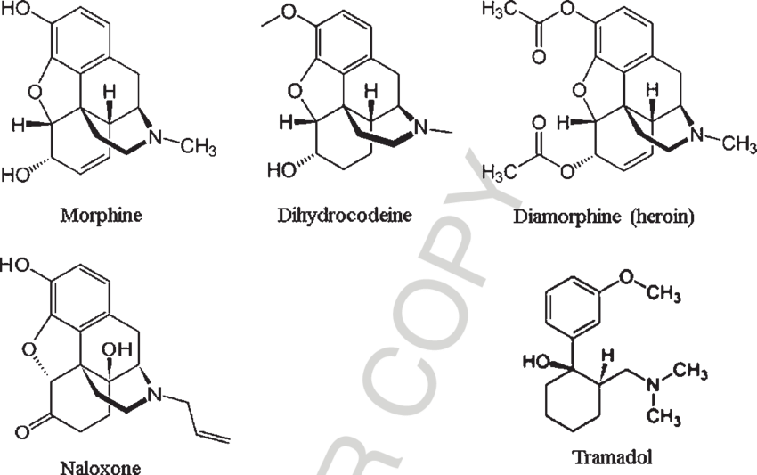

Slide 10
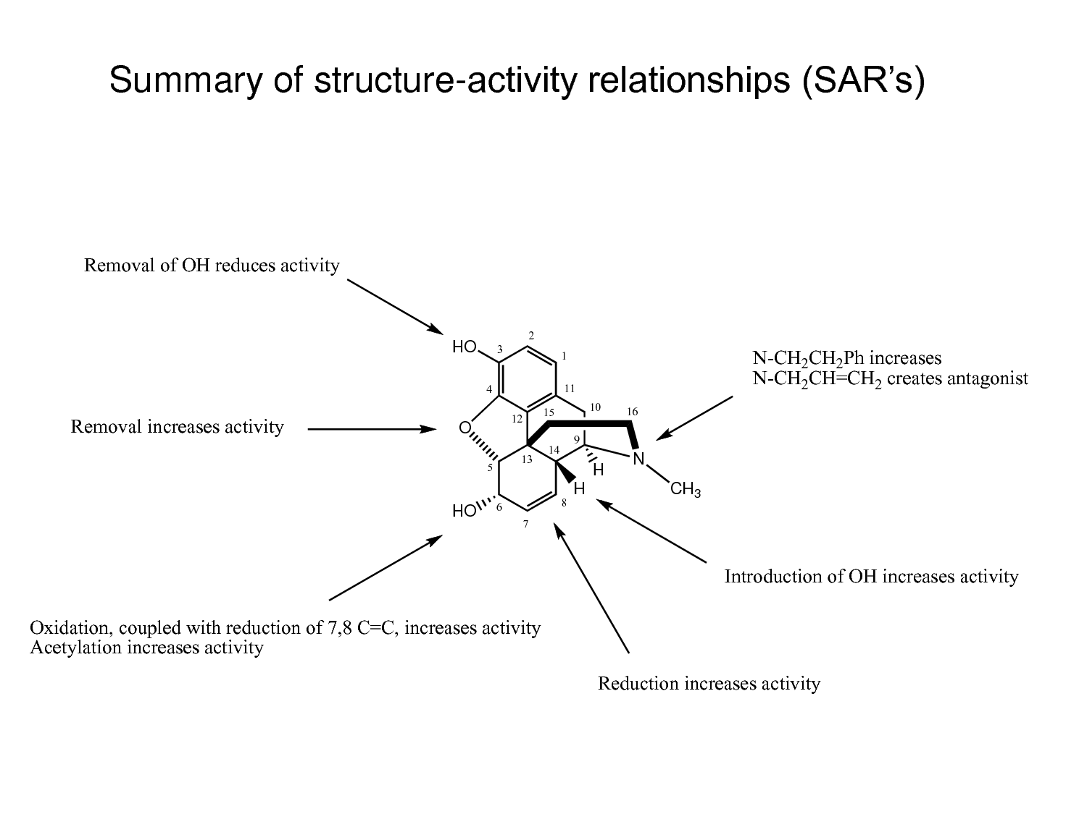

Slide 11
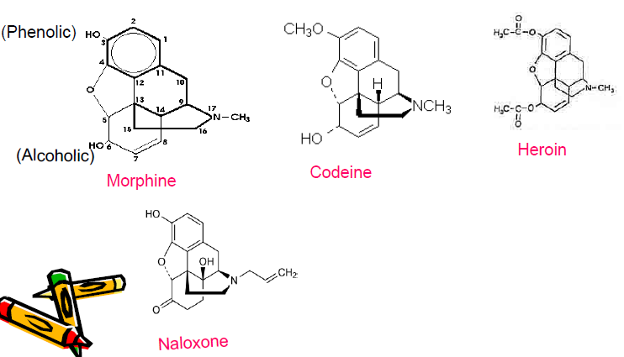

Slide 12
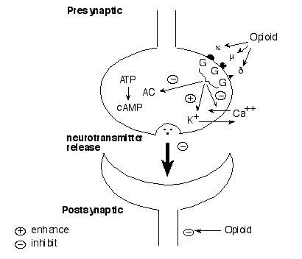
Mechanism:

Slide 13
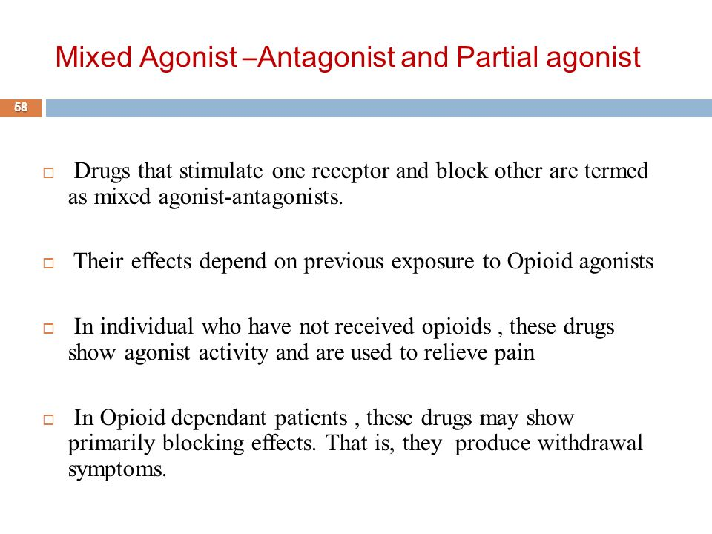

Slide 14
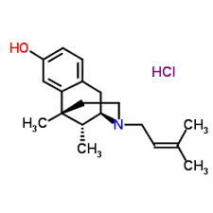
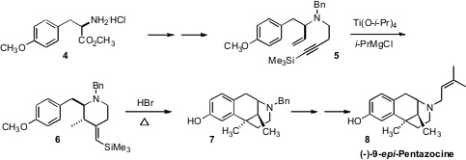
Pentazocine is a mixed agonist/antagonist.
Synthesis:

Slide 15

ANTITUSSIVE

Slide 16
DEFINITION
ANTITUSSIVE:-
A drug that suppresses coughing possibly by reducing the activity of the cough center in the brain
Classification of cough
Acute:- less than 3 weeks.
Sub-Acute:- between 3-8 weeks.
Chronic:- longer than 8 weeks.

Slide 17
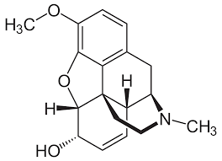
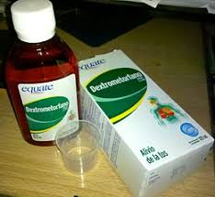
CLASSIFICATION
CENTRALLY ACTING ANTITUSSIVE:-
The centrally acting antitussives consists primarily of the phenanthrene alkoloid of opium. These drugs selectively act on the medullary centre to suppress the cough reflex.
Narcotic antitussive:-
Codeine
Hydrocodone
Oxycodone
Non-narcotic antitussive:-
Dextromethorphan
Noscapine
Propoxyphene

Slide 18
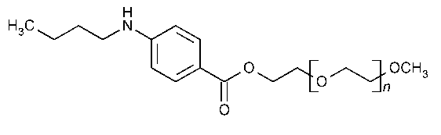
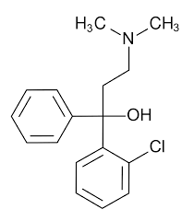
2) PERIPHERALLY ACTING ANTITUSSIVE:-
Mucosal anaesthetics:-
Benzonatate: its structurally releted local aneasthetic tetracaine.
Chlophedianol
Hydrating agents:-
Steam
Aerosols
Miscellaneous:-
Bromhexine

Slide 19

thankyou
THANK YOU

