Slide 1
ISO 9000
INTERNATIONAL STANDARDS FOR ORGANIZATION
Presented By
K. Gayathri Devi, M. Pharm.,
Assistant Professor,
Department Of Pharmaceutical Analysis,
MAM College Of Pharmacy,
Kesanupalli.

Slide 2
Introduction to ISO 9000
•The ISO 9000 family of standards is related to quality management systems and designed to help organizations ensure that they meet the needs of customers and other stakeholders while meeting statutory and regulatory requirements.
• ISO 9000 deals with the fundamentals of quality management systems, including the eight management principles on which the family of standards is based.
International standards promote international trade by providing one consistent set of requirements recognized around the world.
• ISO 9000 can help a company satisfy its customers, meet regulatory requirements and achieve continual improvement. It provides the base level of a quality system, not a complete guarantee of quality.
• Originally published in 1987 by the International Organization for Standardization (ISO), a specialized international agency for standardization composed of the national standards bodies of 90 countries..

Slide 3
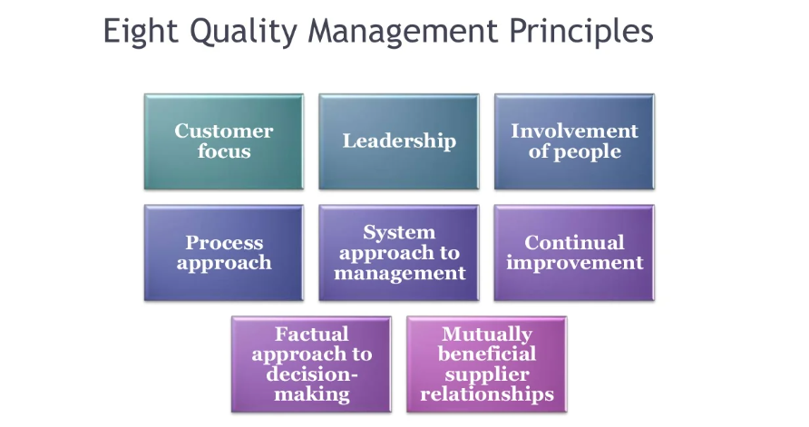

Slide 4
ISO 9000 Series
ISO 9000:
Explains fundamental quality concepts and provides guidelines for the selection and application of each standard
ISO 9001:
Model for quality assurance in design, development, production, installation and servicing.
ISO 9002:
Model for quality assurance in the production and installation of manufacturing systems.
ISO 9003:
Quality assurance in final inspection and testing.
ISO 9004:
Guidelines for the applications of standards in quality management and quality systems.
ISO 9000 and ISO 9004 are guidance standards. They describe what is necessary to accomplish the requirements outlined in standards 9001, 9002 or 9003.

Slide 5
Advantages
Quality is maintained
ISO registration also has a significant bearing on market credibility as well.
Opportunity to compete with larger companies
More time spent on customer focus
Confirmation that your company is committed to quality
May facilitate trade and increased market opportunities
Can increase customer confidence and satisfaction.

Slide 6
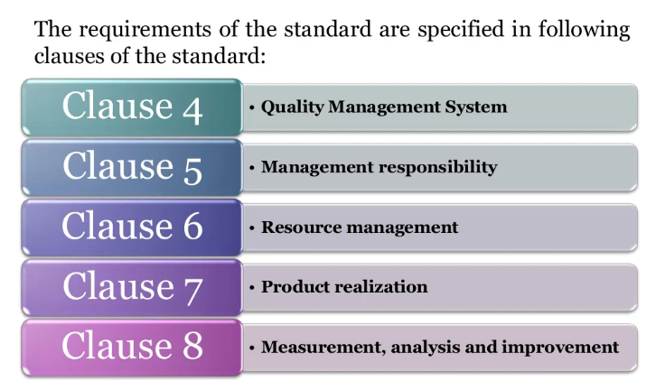
CLAUSES

Slide 7
Quality Management Clause
General requirements
Documentation requirement
Quality manual
Control of records and documents
Management responsibility clause
Customer focus
Quality objective
Quality policy
Quality management system planning
Management representative
Internal communication

Slide 8
Resource management requirement clause
Competence, awareness and training
Infrastructure
Work environment
• Product realization requirement clause
Planning of product realization
Customer related process
Customer communication
• Measurement, analysis and improvement clause
General requirements
Monitoring and measurement
customer satisfaction
Internal audit
Analysis of data
Continual improvement

