Slide 1


DIURETICS
ALETI VAMSI
principal ,HOD&Professor
Dept.of pharmceutical chemistry

Slide 2
contents
1. Introduction
2. Anatomy and physoilogy of nephron
3. Classification of diuretics
4. Diuretics as antihypertensives
5. Diuretics in heart failure

Slide 3
INTRODUCTION
DIURETICS are drugs that promotes the output of urine by the kidneys.
These are commonly known as water pills.
Used to treat kidney diseases, congestive heart failure, hyper tension, and liver cirrhosis.
By using these drugs mainly arises the condition in which the body loses water through excess urination.

Slide 4
Anatomy and physiology of nephron
Nephron is the structural and functional unit of kidney.
Each kidney contains about one million of nephrons
Each nephron is composed of an initial filtering component -Renal corpuscle and a tubule specialized for reabsorption and secretion -Renal tubule.
Renal corpuscle
Composed of a glomerulus and the Bowman’s capsule, the renal corpuscle (or Malpighian corpuscle) is the beginning of the nephron. It is the nephron’s initial filtering component.
The renal corpuscle filters out solutes from the blood, delivering water and small solutes to the renal tubule for modification.
Renal tubule:
The components of the renal tubule are,
Proximal convoluted tubule
Loop of henle
Distal convoluted tubule
Collecting duct

Slide 5
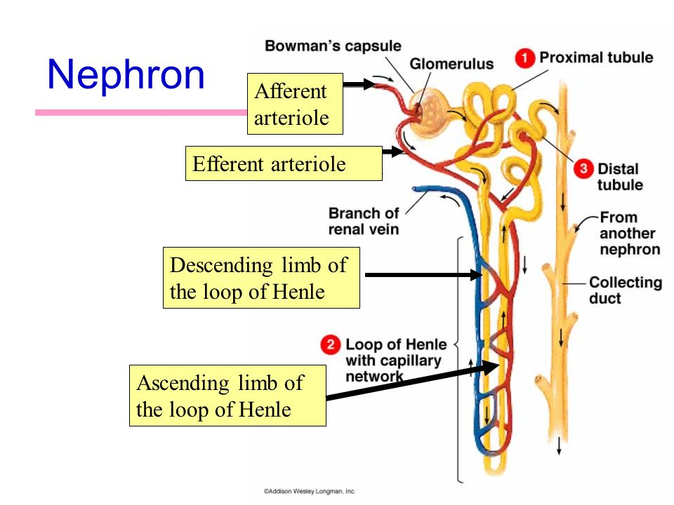
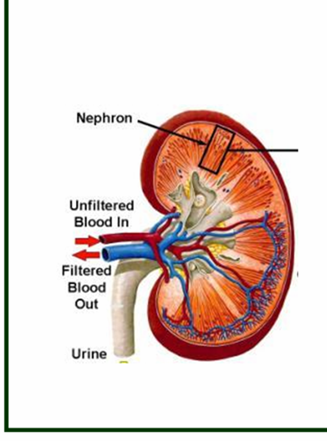
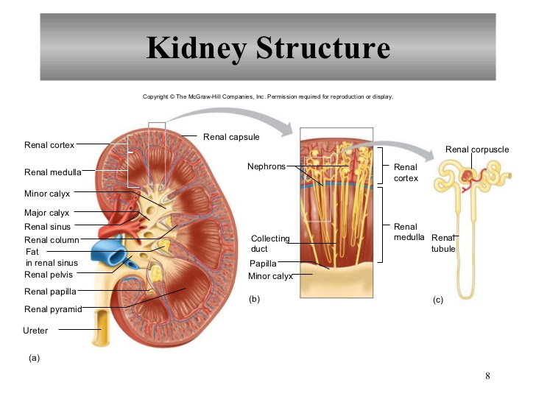

Slide 6
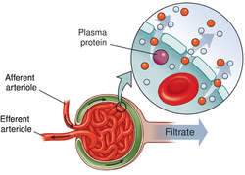
The Glomerulus
A tiny capillary network structure in the nephron, called glomerulus, acts as a filtering unit.
Urine formation starts from Glomerular Filtration.
Around 180 Liter of fluid is filtered everyday in glomerulus. All soluble constituents of blood except plasma proteins and lipids are filtered at glomerulus.
But more than 99% of the glomerular filtrate is reabsorbed in the tubules. So inspite of 180 liter fluid filtration in glomerulus, only 1.5 liter of urine is produced in 24 hours
The rate of filtration from the glomerulus to the Bowman's capsule is determined by the Starling equation
GFR = kf {(Pgc – Pbc)} – {(πgc – πbc)}

Slide 7
Proximal convuluted tubule
Glucose, bicarbonate, amino acids and other metabolites are reabsorbed.
Two-third of Na⁺ is reabsorbed, Chloride enters in exchange for a base anion, such as formate and oxalate.
The transport of Na⁺,HCO3,and Cl- are important for actions of diuretics.
Water follows passively to maintain iso-osmolarity.
Direct entry of Na⁺ along with electrochemical gradient.
Na⁺/ K⁺ pump. Transfer of Na⁺ and Ca⁺⁺ coupled to active reabsorption of glucose, amino acids and other organic anions & PO₄⁻³ through specific symporters.
Exchange of H⁺:
Proximal tubule cells secrete H⁺ with the help of carbonic anhydrase.
Large amount of HCO₃⁻,amino acid, acetate create driving force for Cl⁻ to diffuse through paracellular pathway.

Slide 8
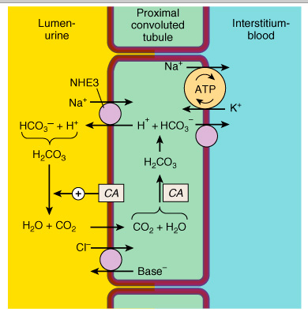

Slide 9
Loop of henle
DESCENDING LOOP OF HENLE
The filtrate entering here is isotonic due to water reabsorption in this area.
Tubular fluid becomes concentrated (Hypertonic) (Three fold increase in salt concentration).
ASCENDING LOOP OF HENLE
ASCENDING LOOP OF HENLE (Medullary part lined by cuboidal cells).
Unique. Impermeable to water.
Active reabsorption of Na⁺, K⁺ & Cl⁻ is mediated by a Na⁺/K⁺/2Cl⁻ Cotransporter.
Mg⁺⁺ and Ca⁺⁺ enter the interstitial fluid.
25% to 30% of tubular NaCl returns to the interstitial fluid (blood). So, Loop of Henle is called diluting region. A major site for salt reabsorption.

Slide 10
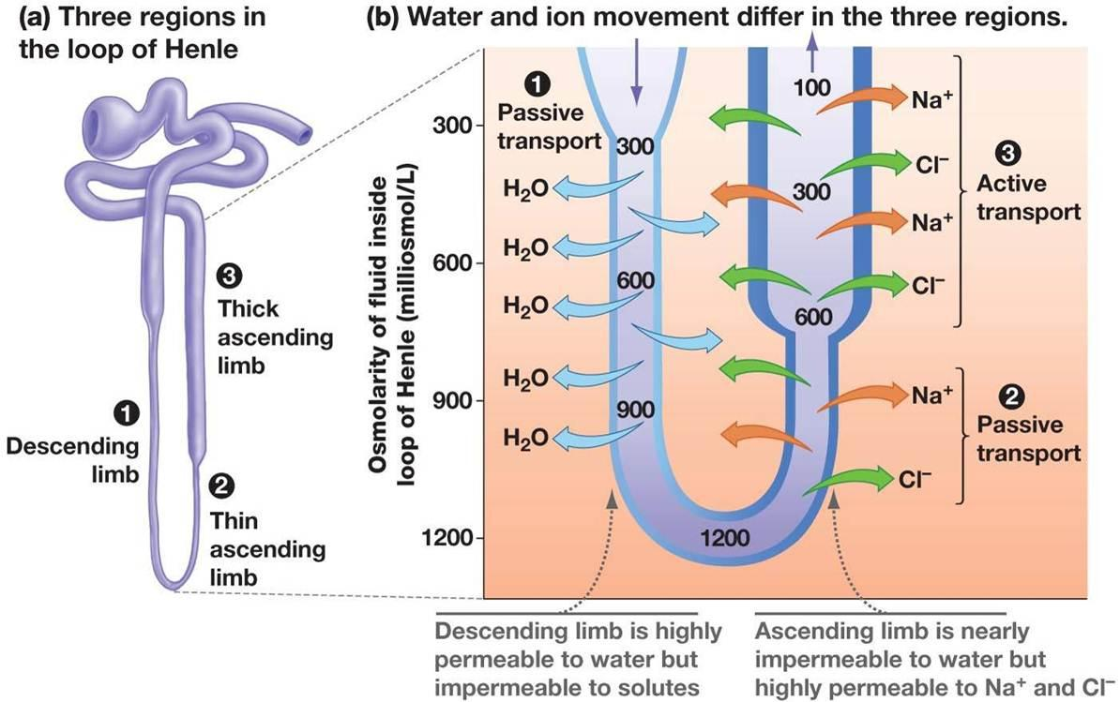
2. ASCENDING LOOP OF HENLE (Cortical part lined by flattened cells).
Impermeable to water.
Salt reabsorption continues but through Na⁺-Cl⁻ symporters.
Tubular fluid gets further diluted

Slide 11
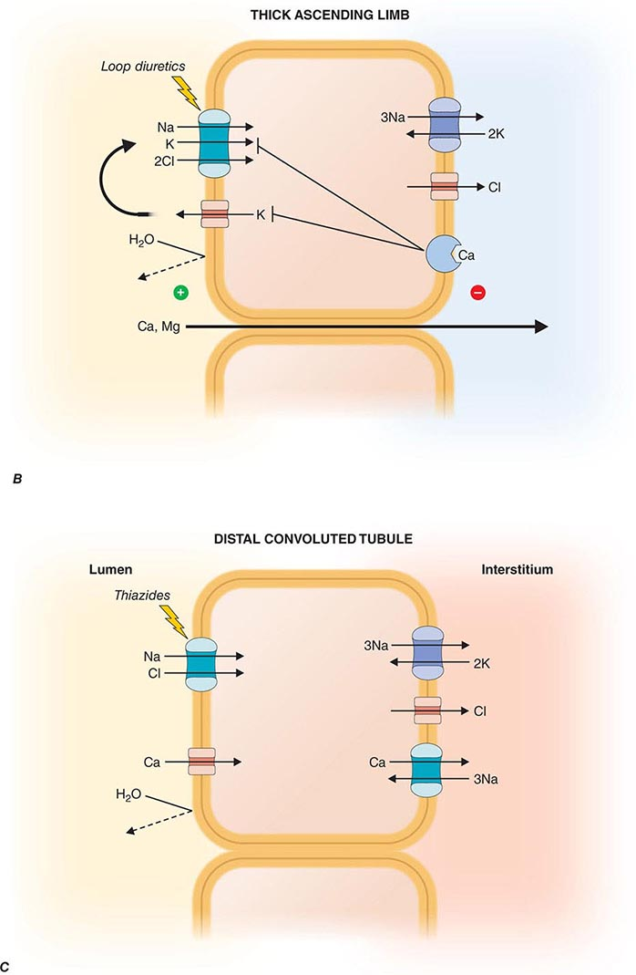
DISTAL CONVULATED TUBULE
Impermeable to water.
10% of filtered NaCl is reabsorbed via Na⁺/Cl⁻ transporter that is sensitive to Thiazide diuretics.
Calcium reabsorption mediated by Na⁺/Ca⁺⁺ exchanger into the interstitial fluid.

Slide 12
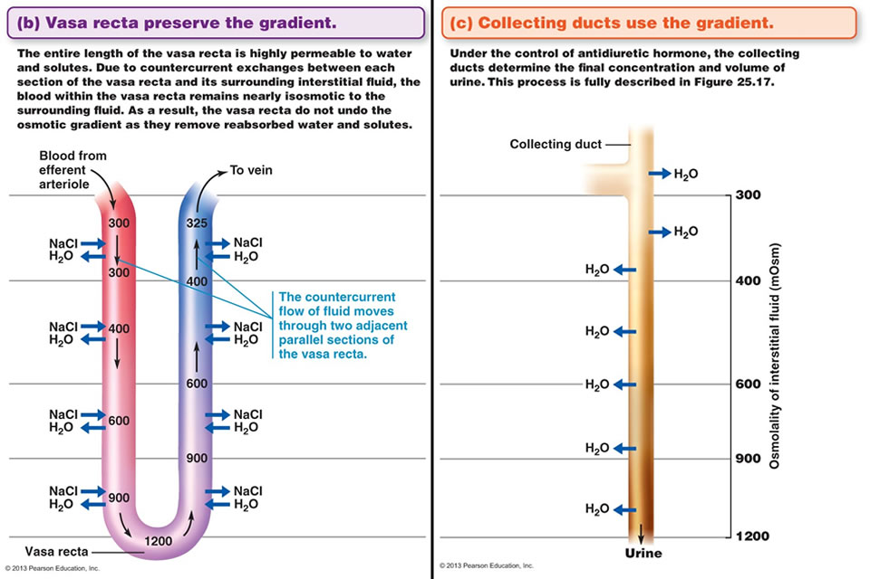
Collecting duct
Na+ reabsorptoin, k+ excretion
Aldosterone receptors in tubular cells influence Na⁺ reabsorption & K⁺ secretion.
Absorption of Na⁺ at this site occurs through a specific amiloride sensitive Na⁺ channel & controlled by aldosterone.
ADH promotes reabsorption of water from the collecting tubule mediated by cAMP.

Slide 13
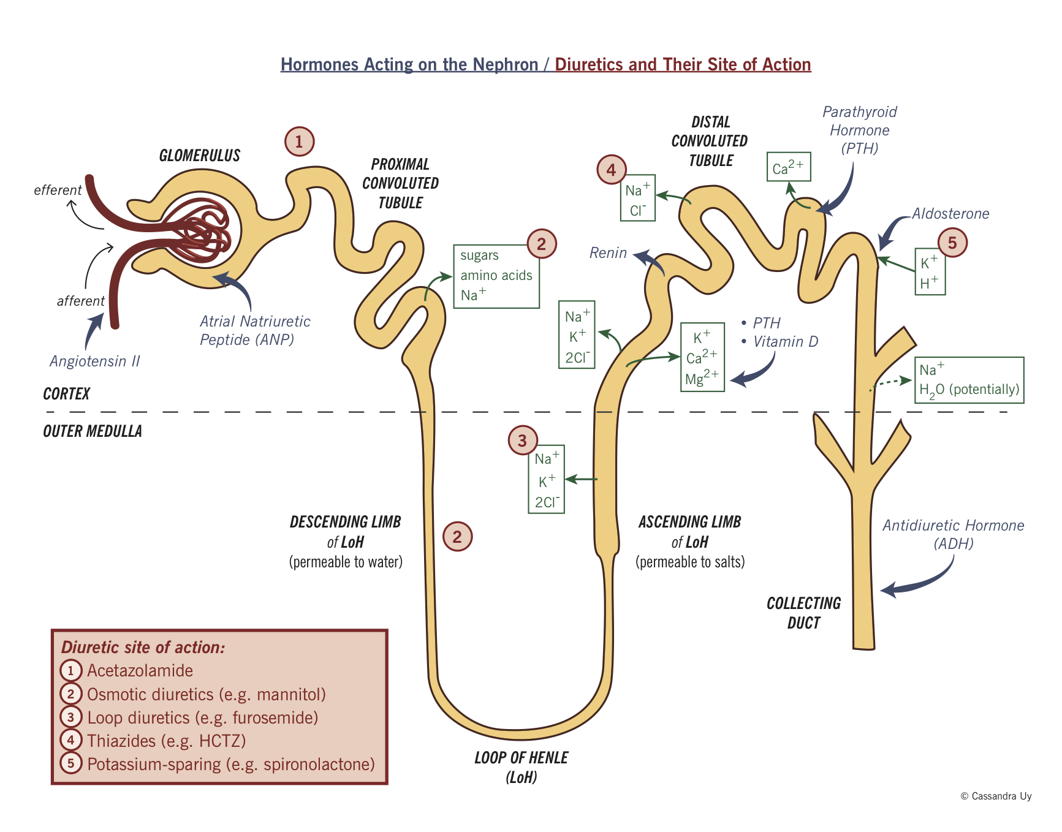
Classification of diuretics based on site of action

Slide 14

Classification of diuretics based on site of action
Drugs used in renal disorders
Drugs that modify salt excretion
Drugs that modify water excretion
PCT
TAL
DCT
CCT
ADH agonist
ADH antagonist
Loop
diuretics
Thaizide
diuretics
K+ sparing
diuretics
Lithium salts,
demeclocycline
Osmotic
diuretics
Carbonic anhydrase
inhibitors

Slide 15
CONT…….
Weak Diuretics:-
  Osmotic Diuretics: Electrolytes: Sodium Chloride,
  Potassium citrate, Potassium carbonate, Potassium acetate, Potassium chloride.
  Nonelectrolytes: Mannitol, Isosorbide, Sucrose, Urea, Glycerol.
  Acidifying salts: Ammonium chloride, Arginine hydrochloride.
  Xanthine derivatives: Aminophylline, Theophylline
  Carbonic anhydrase inhibitors: Acetazolamide, Dichlorphenamide, Ethozolamide, Methazolamide

Slide 16
B. Moderately potent Diuretics:-
  Thiazide Diuretics : Bendrofluazide, Clopamide, Hydrochlorthiazide,Chlorthalidone,Chloroxolone, Indapamide, Polythiazide, Cyclopenthiazide.
C. Very Potent Diuretics:-
  Loop Diuretics: Furosemide, Ethacrynic acid, Torsemide,Bumetamide,Peretanide,Indacrinone.
  Mercurials:Mersalyl,Mercaptomerin,Meralluride, Chlormerodin, Mercurous chloride (Mersalyl).

Slide 17
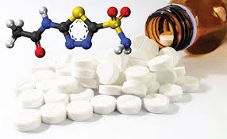
Carbonic anhydrase inhibitors
Carbonic anhydrase inhibitors like ACETAZOLAMIDE,METAZOLAMIDE inhibit NAHCO3 reabsorption by inhibiting the carbonic anhydrase enzyme which catalysis the rehydration of H2CO3.
Decreases H+ for Na+/H+ exchange resulting loss of HCO3 and Na+ in urine
Finally it produces diuretic acton.
H2O + CO2 H2CO3 HCO3 + H+
Therapeutic uses :
Glaucoma, urinary alkanization,
Epilepsy – in chlidrens combination of other antiepileptic drugs
Acute mountain sickness
Adverse effects:
Hyperchloremic Metabolic Acidosis
Renal Stones
- Calcium salts are relatively insoluble at alkaline pH.
  So the potential for renal stone formation from these salts is enhanced.
Hyper calciuria
Parestheasis on large doses
Carbonic anhydrase

Slide 18
ACETAZOLAMIDE

Slide 19
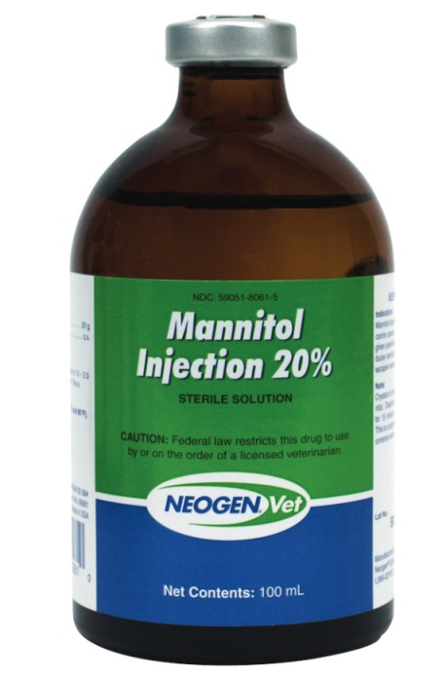
Osmotic diuretics
Mannitol, Isosorbide ,Sucrose, Urea, Glycerol.
Any osmotically active agent promotes a water diuresis.
The prototypic osmotic diuretic is mannitol.
Mechanism of action:
Mannitol exerts osmotic pressure in the PCT tubular fluid retaining the water in tubular segments, then causes watery diuresis.
Oral mannitol causes osmotic diarrhea so for systemic effect, it is given parenterally.
they also oppose the action of ADH.
They reduce Na⁺ as well as water reabsorption
Therapeutic uses:
Promotion of diuresis
To prevent Anuria
Adverse effects:
Hyonatremia
Oedematic condition

Slide 20
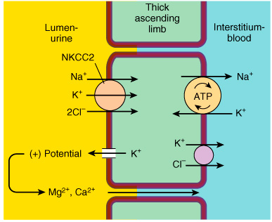
Loop diuretics
Furosemide, Ethacrinic acid, toresmide.
Mainly acts at thick ascending limb of loop of henle.
They inhibit the NKCC2 in the apical membrane of the loop, there by inhibit the reabsorption of NaCl.
Dimnishes positive potential in lumen,causes more exrcetion of Mg+, Ca+.

Slide 21
Therapeutic Uses:
Diuretic actions of Loop Diuretics:
Oedema due to CHF,nephrotic syndrome.
Acute pulmonary edema & cerebral edema, pregnancy & idiopathic edema.
Acute chronic renal failure.
Barbiturate poisoning, salicylate poisoning.
Nondiuretic action of Loop Diuretics:
As an antihypertensive.
2. Diabetes insipidus.
Synthesis of furosemide

Slide 22
Thaizides
Active at distal convulted tubule
Chlorthaizide, Hydrochlorthaizide, indapamide etc..
Thiazides inhibit NaCl transport in the DCT by blocking Na⁺/Cl– transporter (NCC).
Thiazides actually enhance Ca²⁺ reabsorption
They are useful for kidney stones caused by hypercalciuria.
The term "thiazide" is also often used for drugs with a similar action that do not have the thiazide chemical structure, such as chlorthalidone and metolazone.
Clinical indications
  Hypertension
  heart failure
  nephrolithiasis due to idiopathic hypercalciuria,
  nephrogenic diabetes insipidus
ADVERSE EFFECTS
Hypokalemia Metabolic Alkalosis and Hyperuricemia
Allergic Reactions (the thiazides are sulfonamides).
Hyponatremia is an important adverse effect of thiazides.

Slide 23
Synthesis of chlortaizide:

Slide 24
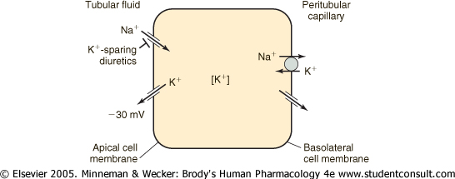
Potassium sparing diuretics
Spiranolactone, Epierenone, Amiloride, Triamterene.
These are either aldosterone antagonist or directly inhibit Na+ channels in DT and CD cells to indirectly conserve K+.
Pharmacologic antagonists of aldosterone in the collecting tubules
Combine and block intracellular aldosterone receptor leads to controlling synthesis of sodium ion channels and Na⁺/K⁺ ATPase.
Increase sodium clearance and decrease K+ & H+ excretion.

Slide 25
Therapeutic uses:-
Treatment of potassium wasting caused by chronic therapy with loop and thiazide diuretics (combination in a single pill).
Treatment of aldosteronism in cirrhosis and heart failure.
Adverse effects:-
Hyperkalemia is the most important toxicity.
Can cause endocrine abnormalities (gynecomastia and antiandrogenic effects).

Slide 26
Diuretics as antihypertensives
There are many classes of antihypertensives, which lower blood pressure by different means. Among the most important and most widely used drugs are thiazide diuretics.
Diuretics cause the kidneys to remove more sodium and water from the body, which helps to relax the blood vessel walls, thereby lowering blood pressure.
The diuretic and mild vasodilator actions of the thiazides are useful in treating virtually all patients with essential hypertension
Mostly Esidrix(hydrclorthizide), Zaroxolyn(metalozone) are used combination with angiotensin blocker, ACEinhibitors.

Slide 27
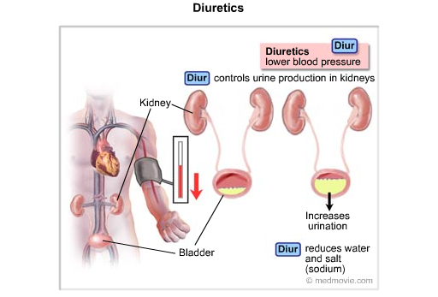
Although diuretics are often successful as monotherapy, they also play an important role in patients who require multiple drugs to control blood pressure. Diuretics enhance the efficacy of many agents, particularly ACE inhibitors. Patients being treated with powerful vasodilators such as hydralazine or minoxidil usually require simultaneous diuretics because the vasodilators cause significant salt and water retention.

Slide 28
Diuretics in heart failure
Diuretics cause the kidneys to remove more water and salt (sodium) from your body. This can help relieve swelling that happens because of heart failure.
Examples
1. Loop diuretics - Bumetanide • Furosemide • Torsemide
2. Potassium-sparing diuretics - Amiloride • Spironolactone
Thiazide diuretics cause moderate increases in water excretion and are appropriate for long-term use. Loop diuretics are more powerful and are especially useful in emergencies. Potassium-sparing diuretics help your body retain the mineral potassium and are often prescribed in conjunction with the other two types of diuretics.
Edema associated with heart failure is generally managed with loop diuretics. In some instances, salt and water retention may become so severe that a combination of thiazides and loop diuretics is necessary.

Slide 29
In treating the heart failure patient with diuretics, it must always be remembered that cardiac output in these patients is being maintained in part by high filling pressures. Therefore, excessive use of diuretics may diminish venous return and further impair cardiac output. This is especially critical in right ventricular heart failure.
Diuretic-induced metabolic alkalosis is another adverse effect that may further compromise cardiac function. This complication can be treated with replacement of K⁺ and restoration of intravascular volume with saline; however, severe heart failure may preclude the use of saline even in patients who have received excessive diuretic therapy. In these cases, adjunctive use of acetazolamide helps to correct the alkalosis.

Slide 30


