Slide 1
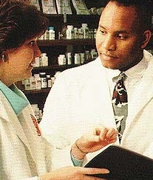

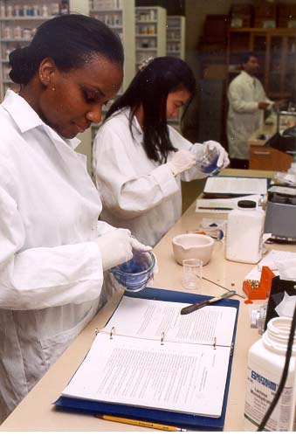
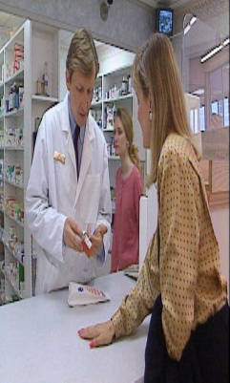
Future Prospects in Pharmacy

Slide 2
What is Pharmacy?
Pharmacy is the branch of science which deals with the study of chemistry of drugs, their origin, procedures for drug development, their preparation, dispensing, their effects and eventual use for prevention and treatment of disease.

Slide 3
Pharmacists are highly qualified professionals with a specialism in medicines. Studying pharmacy is intellectually demanding and stimulating as you will acquire in-depth knowledge of a range of subjects from the basic and applied sciences such as physiology, biochemistry and advanced neuropharmacology to social pharmacy concepts. You will develop advanced communication and problem-solving skills as well as research skills in the laboratory or practice setting. The M. Pharm course provides graduates with the skills required to follow a variety of career paths.

Slide 4
Tomorrow's World
Pharmacists even have a hand in assessing applications by drug companies to manufacture new medicines, helping to protect public health and maintain standards. This increasingly vibrant profession is changing all the time. For example, there will be an increasing role to play in social care. New roles are evolving constantly.
So you see, that dictionary definition doesn't quite tell the whole story.

Slide 5
Where Can Pharmacy Take Me?
Pharmacy can put you squarely in the role of a key player in the future of healthcare worldwide. But what do pharmacists actually do? And where do they put their skills to use? It all depends on what branch of the profession you choose.

Slide 6
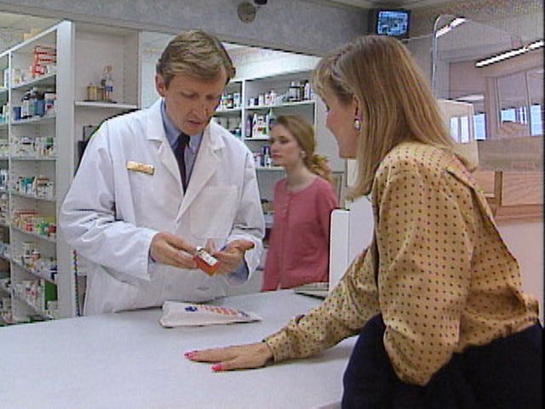
Why Pharmacy?
A well-rounded career
A vital part of the health care team
Outstanding career opportunities
Excellent earning potential
A trusted profession

Slide 7
Satisfaction
Great satisfaction can be achieved by taking care of patients’ drug therapy needs and helping patients to understand their medicines.
Credibility
The Pharmacy Profession has a high level of credibility, and importance to our communities, resulting in being one of the "Most Trusted Professionals”
Rewarding
The care Pharmacists give is in great demand. Pharmacists in all practices are in demand all over the world. Personal and professional rewards are huge.
Flexibility
A pharmacy degree can lead to a wide range of careers in practice, industry, education, government, managed care, consulting, and many other areas. It can include ownership, entrepreneurial opportunities or part-time work as your needs and goals change.
Career Options
Traditionally, the most popular career choices for pharmacists have been in either the community practice setting, both independent and chain pharmacy, or in the hospital setting. As health care has advanced, so have career opportunities for pharmacists. Listed below are some of the many careers for doctor of pharmacy graduates of today. Many more career options are still out there, waiting for you to define them.
WHY CHOOSE A CAREER IN PHARMACY?

Slide 8
Reasons for Choosing Pharmacy as a Career
Hospital Pharmacy: Professionals who wish to be associated with hospitals can go for hospital pharmacy. Here they work as the essential part of clinical ward and provide doctors and nurses with effective advice on medicine.
Industrial Pharmacy: A person with interest in research can go for industrial pharmacy that allows them to work with different pharmaceutical companies where their job is more like scientists. They can conduct various experiments and analyze the end results of the drugs and medicines.
Academic Pharmacy: People who love to teach can go for academic pharmacy where they can combine teaching and researching and have great career with some good universities. It is a great opportunity to share and pass on your knowledge with willing students.

Slide 9
Retail Pharmacy: People interested in private stores can go for retail stores where they can work as authorized distributors of medicine once they get the license for it. Basically, it is like a shop where people will come and buy whatever medicines they need.
Community Pharmacy: Those who are interested in primary health care can go for community pharmacy where their role is to use and apply their knowledge, skills, and expertise for the effective implementation of the primary health care. They make sure that health care professionals make the right, safe and appropriate use of available medicines.
Regulatory Pharmacy: Those who are interested in working on the policy levels can go for regulatory pharmacy. Here, the professionals work with government bodies to protect and improve the public health. They make sure that the drugs manufactured by the companies are safe and before they are marketed to the public.
Veterinary Pharmacy: Pharmacy technicians having passion for animal health can try veterinary pharmacy. They deal with medicines and drugs manufactured, marketed and dispensed by veterinary doctors. In rural settings they help farming industry by providing right medication to livestock.

Slide 10
Eligibility
The minimum 50% in PCMB or PCM/B
in HSC Board Examination.
Non zero score in PMT/PET or GPAT

Slide 11
Courses Offered…
B. Pharmacy - 4 yrs. Course
M. Pharmacy - 2 yrs. Course
Pharm. D - 6 yrs.(integrated course)
Ph.D

Slide 12
Goals of Pharmaceutical Care
Cure disease
Eliminate or reduce symptoms
Stop or slow a disease
Prevent disease
Change physiological processes to improve the health of a patient with minimal risk

Slide 13
What Do Pharmacists Do?
Educate patients about prescription and over-the-counter medications
Advise other health care professionals on drug decisions for patients
Provide expertise about the composition of drugs, including chemical, biological and physical properties, as well as on use
Ensure drug purity and strength
Ensure drugs do not interact in a harmful way

Slide 14
PHARMACISTS
are
Drug Information Experts
No one knows more about medications than pharmacists

Slide 15
Shortage of Pharmacists
Nationwide shortage of pharmacists throughout world various industries*
Shortage expected to last into the foreseeable future
Why?
  Increase in number of new prescription medicines
  Growing elderly population
  Greater demand for patient care
  Growth in community pharmacy
  Increase numbers of industries
  More strict rule and regulation for pharmaceutical field
* According to the results of the National Pharmacist Workforce Survey (2006) and the National Center for Health Workforce Analysis, US (2000).

Slide 16
JOB OUTLOOK
Nationwide Shortage = Increased Demand
Student pharmacists can expect multiple job offers at graduation
Median salary in 2009 = $107,403 in US *According to DrugTopics.com
Regional mobility - Demand for pharmacists is widespread in world.
Opportunities to work in wide variety of health care and industry settings
Involves variety of task to be performed.

Slide 17
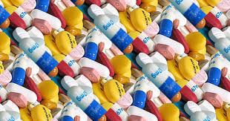
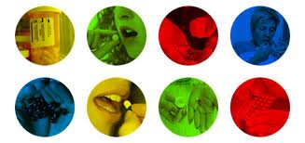

10 Reasons to choose the Pharmacy…
A very noble and respected profession.
Involves helping the People with what is often their No.1 priority – health.
Excellent employment opportunities .
Involves variety of task to be performed.
A vital part of health care team.
Excellent earning potential
Provides continues learning opportunities
Outstanding career opportunities.
Makes you independent
You can take your pharmaceutical skills any where in country or for that matter world

Slide 18
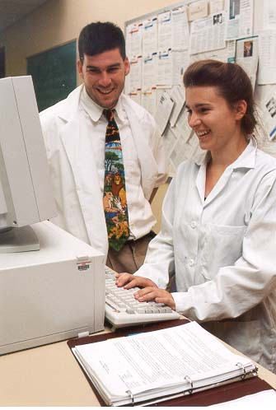
Should YOU Be a Pharmacist?
DO YOU LIKE...
Chemistry, Biology, and Math?
To Help People?
Want to do new in your life?
ARE YOU...
Dependable? Organized?
Detail-Oriented?
Able to Communicate Well with Others?
If you answered YES, you may want to consider pharmacy as a career!

Slide 19
An overview of Indian Pharmaceutical Industry
Indian pharmacy has been self sufficient and well known all over the world for producing quality medicine at economic price
Today in India there are close to 20 pharmaceutical companies, which meets about 40% of the worlds bulk drug requirement.
Indian pharmacy industry is highly organized sector. estimates show Indian pharma to be worth $4.5 billion ,going at about 8-9% annually .it ranks very high in the third world ,in terms of technology , quality &range of medicines manufactured

Slide 20
An overview of Indian Pharmaceutical Industry
In today’s world pharmacy research becoming more &more IT oriented. India is in position to leverage on its strong IT base thus, India is becoming an important destination for MNCs, which are increasingly considering out sourcing & off shoring their drug discovery, research & development and clinical research.

Slide 21
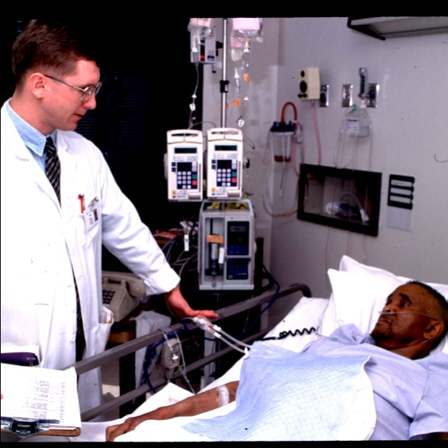
Pharmacy Career Options
Academic Pharmacy
Community Pharmacy
Government Agencies
Hospice & Home Care
Hospital & Institutional Practice
Independent Ownership
Long-term Care
Consulting Pharmacy
Managed Care Pharmacy
Research
Medical writing
Clinical Trials
Pharmaceutical Industry
Trade & Professional Associations
Uniformed (Public Health) Service
Medical & Scientific Publishing

Slide 22

Manufacturing
They can handle the job of monitoring the manufacturing activities in drug manufacturing industry, formulations manufacturing and cosmetics Industry. They can rise to the position of a General Manager / Plant Manager in Pharmaceutical Industry.
The Pharmacist can have his own manufacturing industry or can start on Loan License Manufacturing or conduct his own marketing by outsourcing products from the manufacturing industry on contractual agreements

Slide 23
Practicing Pharmacist
Being in the health-related field, the B Pharm graduate
can be an integral part of the Health Care Team as community Pharmacist or Hospital Pharmacist.
Quality Assurance
The Pharmacy graduate can play an important role in the development of GMP in manufacturing, can investigate adverse medication events reported and investigate complaints, follow up on records and given an assurance of proper drug delivery, stability and therapeutic efficacy of drug product

Slide 24

Medical Transcription
The B. Pharm. graduate can work with medical practitioners to develop and update patient medical record i.e. Patients medical history, the drug to which he/she is allergic, various treatments given etc.
Analytical / Quality Control
The pharmacy graduate can play a crucial role in developing and quality control methods thus ensuring good quality products through its shelf life. – This is achieved by being part of the quality control team in a manufacturing plant .

Slide 25

Teaching as a career
B Pharm. are eligible to teach as lecturers in the D. Pharm program.
M. Pharm can get a lecturer’s job in pharmacy degree colleges.
While in teaching profession they can do research in pharmaceutical field and strive to become a well-known Research Scientist.

Slide 26


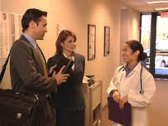
Sales and Marketing
Pharmacists with pleasant personality and good communication skills can opt for the job of Medical Sales Representatives.
Pharma Companies prefer pharmacy graduates due to their extensive knowledge about the drug molecules, their therapeutic effects and drug –drug interactions.
During the course of this career a person can rise to level of Director -Sales

Slide 27
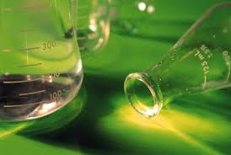

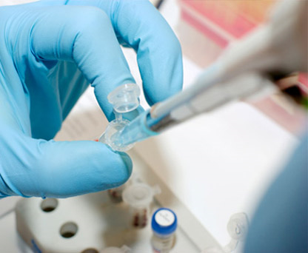
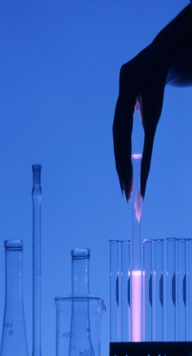
Clinical Research
B.Pharm degree holders can take up career in clinical research. The human testing phase is called the clinical trial. A pharmacist can work as clinical research associate or clinical pharmacist and can rise to the position of Project Manager.
They have to see that the trials meet the international guidelines and the national regulatory requirements.

Slide 28
COMMUNITY PHARMACY
The primary role of a community pharmacist is to provide medication and medication related services to patients. In most settings, pharmacists provide prescription drug services to their community of patients, working with the patients and a broad spectrum of health care providers to achieve the best possible health care outcomes of medications.
Pharmacists may also provide specialty services to patients such as individualized disease management assistance, health screenings and assistance with medical equipment and devices. Pharmacists may work in and own small, independent pharmacy businesses or be a part of a pharmacy team of a large community pharmacy corporation.
Directly helping patients is one of the most appealing parts of this practice setting. Good communications skills and an outgoing personality are valuable traits for pharmacists in this area. This is the most common type of pharmacist practice.

Slide 29
HOSPITAL PHARMACY
The primary role of a hospital pharmacist is to provide medication and medication management services to patients who are hospitalized or are visiting hospital-based clinics, and to provide medication services to the health professionals who care for patients in hospital settings.
The hospital role varies greatly, depending on the size of the hospital and the services that are provided. A pharmacist in a small rural hospital usually has a wide array of responsibilities. In larger hospitals, pharmacists may specialize in general medication distribution, medication distribution services directed to patients in disease-related hospital wards or clinics, or work as a part of a health care team participating in clinical-decision making regarding medication therapy.
Hospital pharmacists have exposure to many complicated and unique therapy needs including intravenous medication therapy, nutrition, and the specific needs of newborns and the elderly. Pharmacists in the practice find working with other health professionals, work variety and focused clinical care opportunity rewarding. This is the second most common practice area.

Slide 30
PUBLIC SERVICE
Many pharmacists are choosing to become involved in the public sector of health care. They join the uniformed services of the country and perform traditional pharmacist roles or work in public health and regulatory arenas.
Public health sector pharmacists are involved in organizations like the Department of Public Health watching out for the health care of citizens and the Food and Drug Administration working on the monitoring and approval of pharmaceuticals.

Slide 31
CONSULTING & LONG-TERM CARE
Pharmacists who work as consultants, usually to long-term health care facilities, focus on the provision and management of medication systems or on clinical decisions related to patient medication regimens.
This field commonly calls on a pharmacist’s knowledge of drugs dosage requirements for unique populations, drug interactions and the routine monitoring of medication regimens. Good problem solving skills are a must for pharmacists in this field.
The rewards of this practice include direct, long standing relationships with patients, participation in clinical decision making on a health care team and the ability to manage a defined medication delivery system.

Slide 32
TEACHING & RESEARCH IN ACADEMIA
Many pharmacists find rewards as faculty in colleges of pharmacy. These pharmacists enjoy influencing the future of pharmacy by educating future pharmacists and may participate in direct patient care and/or scientific research as well.
Academic pharmacist practice has its rewards in disseminating and discovering new ideas that change medication use, pharmacist practices and health care policy. Pharmacist faculty find their careers to be pleasant in their interaction with people, especially students, and provide them with the flexibility to pursue their own ideas about pharmacy.

Slide 33
MANAGED CARE
Managed care pharmacists work in business environments where the goal is to balance the best quality care with the costs of care. This practice involves the delivery of health care benefits to patients through insurance companies and / or their employers. Pharmacists provide clinical programs, medication usage review services and monitor patients for safety, efficacy and economic efficiency of medication usage. Pharmacists in these practices enjoy working with people and monitoring patient care for populations as well as for individuals.

Slide 34
PHARMACEUTICAL INDUSTRY
In addition to the many opportunities for graduates in the many areas of pharmacy practice there are increasing numbers of opportunities within the Pharmaceutical Industry in advanced and specialized areas, as the depth and breadth of education in pharmacy increases opportunities in industry. This includes the promotion of pharmaceuticals to health professionals, marketing, development of new drugs and dosage forms, clinical studies in patients, monitoring pharmaceutical use on a population scale, and managing regulatory and legal issues.
While there are many positions in the pharmaceutical industry for Doctor of Pharmacy graduates, the path to a unique career depends on the pharmacist’s education. Residencies, fellowships, and advanced graduate education at the M.S. or Ph.D. level open new avenues to pharmacists.

Slide 35
INDUSTRIAL PHARMACIST
This is where an interest in research comes in; developing gene therapy and nano-­medicines, to name just two exciting new areas of medical research. Pharmacists are needed to develop them.
Nano-medicines - the creation of structures 100 nanometres (one nanometre is a billionth of a metre) or smaller in size - are an exciting new development in medicine. Scientists predict that they will soon be applied to disease treatment, targeting key biological aspects of diseases with very low side effects. Industrial pharmacists work alongside scientists who specialise in other areas to discover new ways of combating disease and improving manufacturing and production techniques.

Slide 36
REGULATORY PHARMACY
Regulatory pharmacists work for Government bodies such as the MHRA set up to help protect public health. Their job is to ensure that medicines submitted by drug companies are safe before they can be manufactured and marketed to the public. You need critical evaluation skills for this branch of the profession.

Slide 37
VETERINARY PHARMACY
As a pharmacist you can make a valuable contribution to the welfare of animals by supplying a professional service to pet owners. Since autumn 2005 much more emphasis has been placed by the government on involving pharmacy in the supply of animal medicines and the dispensing of veterinary prescriptions.
More than half of the people who visit a pharmacy own a pet and many of them do not know the correct treatments to give to their cats and dogs for common problems worms and fleas.
Pharmacists in rural settings are often involved in helping the farming industry by supplying medicines for farm livestock.

Slide 38
RESEARCH CAREERS IN PHARMACY
New and expanding knowledge in health care and biomedical sciences provides tremendous opportunities for the pursuit of research careers for pharmacists. Graduates with the Pharm.D. degree can pursue a research career directly or following additional education either in the form of residency and fellowship training or in formal graduate programs leading to the M.S. and Ph.D. degrees.
With a clinical focus one can be involved in the conduct and analysis of large-scale human drug studies in academic, industrial, and governmental settings. Pharmacists are also highly qualified to pursue additional training in business, public health, or pharmaceutical socioeconomics in order to become involved in research in drug utilization, health care outcomes, and the provision of pharmacy services.
Research careers in the basic pharmaceutical sciences: medicinal chemistry, pharmaceutics or pharmacology, frequently require advanced education at the M.S. or Ph.D. level, and usually involve biomedical research activities focused on the molecular-level understanding of drug action, the identification and synthesis of new drug molecules, or the development of safe pharmaceutical products for human or animal use.

Slide 39
CONSULTANT PHARMACIST
A consultant pharmacist often oversees patients in long-term care, monitoring medications and but not always dispensing drugs. These pharmacists serve as a liaison between caregivers and the pharmacy and must know over-the-counter medications, intravenous medications and total parenteral nutrition. Much of the consultant's time is spent monitoring patient charts to ensure that proper medications and dosages are maintained. The consulting pharmacist also monitors state regulations. Skills from hospital and retail pharmacy are vital to this job.

Slide 40
RETAIL PHARMACIST
A retail pharmacist must work according to legal and ethical regulations to ensure the safety of medical products provided to the public. He also provides advice and information to patients regarding the dosage of prescription medications. Other responsibilities include providing over-the-counter medical products and giving patients instructions on prescription drugs and medical devices. Depending on the facility, she may provide blood pressure monitoring and diabetes screening and dispense medications. Sometimes, a retail pharmacist files insurance claims and acts as an intermediary between patients and their health insurance companies. A Pharm.D. degree from an accredited college or university and state licensing is required. The U.S. Department of Labor and the Diploma Guide say that the salary range for a retail pharmacist is between $67,860 and $119,480.

Slide 41
PHARMACY TECHNICIAN
A pharmacy technician may work in a retail store or mail-order pharmaceutical company. He assists pharmacists in dispensing medications, providing customer service and performing administrative tasks. A technician has the responsibility of counting pills, labelling bottles and taking prescription requests. She must verifying a patient’s information is complete and accurate, weigh and measure medication, prepare insurance claim forms and maintain patient files. Employers require a pharmacy technician to receive formal on-the-job training and certification. As of May 2008, the median hourly wage of pharmacy technicians was $9.66 per hour, according to the U.S. Department of Labor.

Slide 42
PHARMACEUTICAL ADVISER
These pharmacists work across primary and secondary care, providing guidance to community and hospital pharmacists in the planning of local pharmacy services.
PRIMARY CARE
Pharmacists work in GP practices providing prescribing advice to GPs and nurses as well as running clinics for patients with long term conditions usually underpinned by their role as qualified independent or supplementary prescribers.
PCT
Pharmacists play a key role in managing the prescribing budget, setting up PCT-wide drug formularies to assure the cost effectiveness of prescribing. They also offer prescribing advice to GPs and non-medical prescribers.

Slide 43

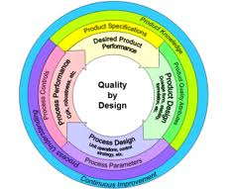

Other Careers
Data Management -A pharmacist can seek employment as “Data Manager” to store the data in the computer and process it using software developed for the purpose.
Regulatory Affairs -A pharmacy graduate can work as “Regulatory Manager”(RM) in companies and contract research organisation. As a RM he has to oversee regulatory documentation such as Clinical trial approval permission, marketing approval permission etc.

Slide 44
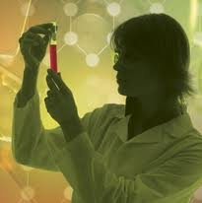


Other Careers (Cont…)
Career in Regulatory bodies -A Pharmacist can be absorbed in the Regulatory bodies like Food and Drug Administration. Pharmacist having experience in clinical trial centre's can also work as an inspector to inspect the clinical trial process. For these government jobs the student needs to appear and pass the PSC examination.
Biotechnology - is a fast growing branch and the B.Pharm graduates can opt for post graduate diploma program in Bioinformatics.

Slide 45
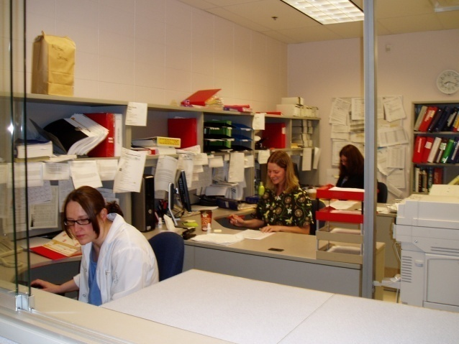

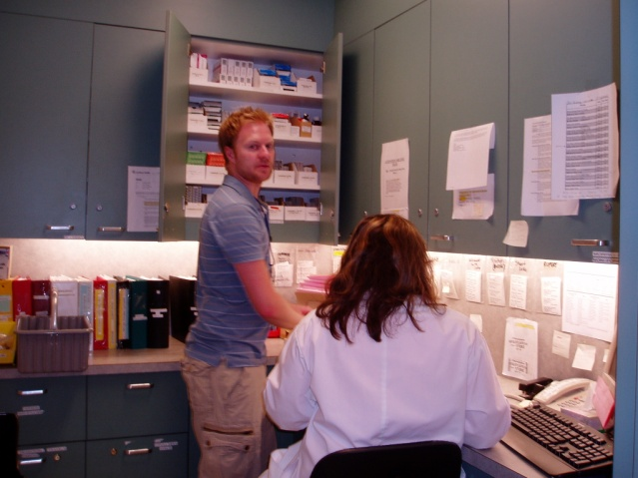
Apart from the areas mentioned, some Pharmacists also work as…………..
Market Researchers
Medical Science Liaison
Nuclear Pharmacist
Consulting Pharmacist
Technical Writer
Public Relations
Marketing Consultants
Further Studies and Research
and more……………………………………

Slide 46
If you enjoy working with people and would like a rewarding career in healthcare, then studying pharmacy is the way forward. The pharmacy degree equips you with an extensive knowledge of medicines, one of the most common interventions used in promoting health and preventing disease.

Slide 47
Go for it!

Slide 48
Good Luck as
you embark on your new career as a Pharmacist

Slide 49
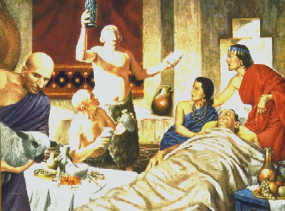
PHARMACY IN ANCIENT BABYLONIA

Slide 50
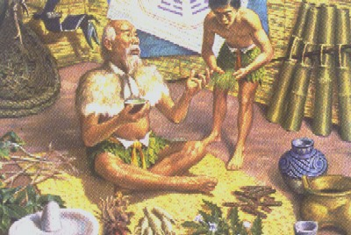
PHARMACY IN ANCIENT CHINA

Slide 51

BEST OF LUCK

Slide 52

M.A.M.COLLEGE OF PHARMACY
Dr.PRASADARAO MANCHINENI
PRINCIPAL
M.A.M.COLLEGE OF PHARMACY KESANUPALLI,NARASARAOPET.

